Slide 1


E-Infrastructure for Science in South Caucasus
Prof. Ramaz Kvatadze
Georgian Research and Educational Networking Association – GRENA
ramaz@grena.ge

Slide 2

Involved Organizations:
Academic Scientific Research Computer Network of Armenia – ASNET-AM www.asnet.am
Armenian Research and Educational Networking Association – ARENA www.arena.am
Azerbaijan Research and Educational Networking Association – AzRENA www.azrena.org
AzScienceNet of the Azerbaijan National Academy of Sciences www.ict.az
Georgian Research and Educational Networking Association – GRENA www.grena.ge
In all three countries there are dedicated organizations working on the development of E-Infrastructure at schools.

Slide 3
Armenia
Academic Scientific Research Computer Network of Armenia – ASNET-AM was created in 1994 by the Institute for Informatics and Automation Problems of the National Academy of Sciences of the Republic of Armenia (IIAP NAS RA).
Armenian Research and Educational Networking Association – ARENA was founded in 2000.
ASNET-AM/ARENA is providing connectivity to the 52 research organizations, 35 universities and 7 libraries.
International connectivity: GEANT link 45 Mbps; in addition links from local providers are used.

Slide 4
ASNET-AM/ARENA Network

Slide 5
ASNET-AM/ARENA Services
Pv4 & IPv6 (dual-stack) multiprotocol connectivity
Mobile broadband 3G access
Managed and guarantied bandwidth (QoS)
IP Telephony
Access to distributed computing infrastructures in Armenia (ArmCluster & ArmGrid)
Secure Data Transmission (VPN, VTUN, EoIP, IP-IP, VLAN, IPVLAN)
Teleconferencing, E-learning, Virtual Desktop
Mail Informer service & WebSMS service
Network monitoring (Nfsen, Nagios, Cacti, Weathermap)
IT Support & Consulting for State stakeholders (Ministry of Education and Science, National Academy of Sciences) and research and educational organizations
Media streaming (Video/Audio Webcast)

Slide 6
Azerbaijan
Azerbaijan Research and Educational Networking Association – AzRENA has been established in 2000 by Azerbaijan’s leading institutes and universities.
AzScienceNet was established at the Institute of Information Technology of the Azerbaijan National Academy of Sciences.
AzRENA/AzScienceNet network connects 11 universities, 35 research institutes and 4 regional research centers.
International connectivity: GEANT link 45 Mbps; in addition links from local providers are used.

Slide 7
AzRENA Network

Slide 8
AzRENA/AzScienceNet Services
Internet connectivity
E-mail, Web-hosting, FTP
Virtual servers
Virtual Private Network (VPN)
Network traffic monitoring and analyses (Nfsen, Nagios, Cacti, Weathermap)
Computer Emergency Response Team - CERT-AZ
Technical support
E-Library service
GRID - distributed computing
HPC – high performance computing
Distance learning program
H.323 based videoconferences

Slide 9
Georgia
Georgian Research and Educational Networking Association – GRENA has been established in 1999 by five major state universities, Georgian National Academy of Science and Open Society-Georgia Foundation.
GRENA is providing connectivity to 45 research and educational institutions.
International connectivity – fully guaranteed backuped 160 Mbps links from local providers.

Slide 10
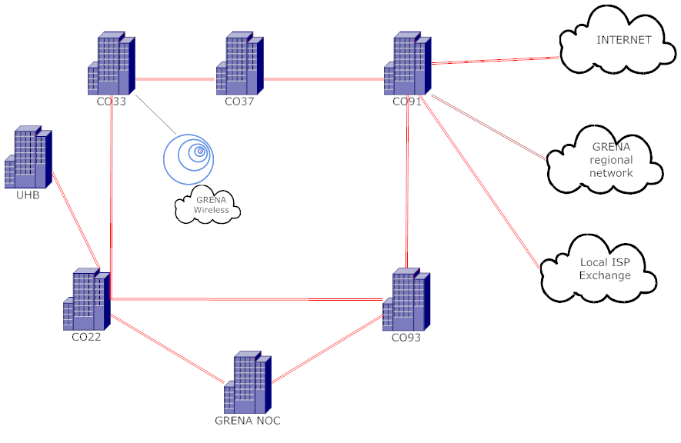
GRENA Network in Tbilisi

Slide 11
GRENA - Services
Internet connectivity, managed and guarantied bandwidth (QoS)
E-mail, Web-hosting, FTP
Virtual servers
Virtual Private Network (VPN)
Network traffic monitoring and analyses (Nfsen, Nagios, Cacti, Weathermap)
Computer Emergency Response Team - CERT-GE
Performance and Enhancement Response Team - PERT
Technical support – hot-line
Software licenses and security solutions
GRID - distributed computing
HPC – high performance computing
Cisco Networking Academy (CCNA, CCNA Security, CCNP, CCIP courses)
Courses on LINUX operation system
Distance learning program
H.323 based videoconferences
Pearson VUE Authorized Center for student’s certification in IT field

Slide 12
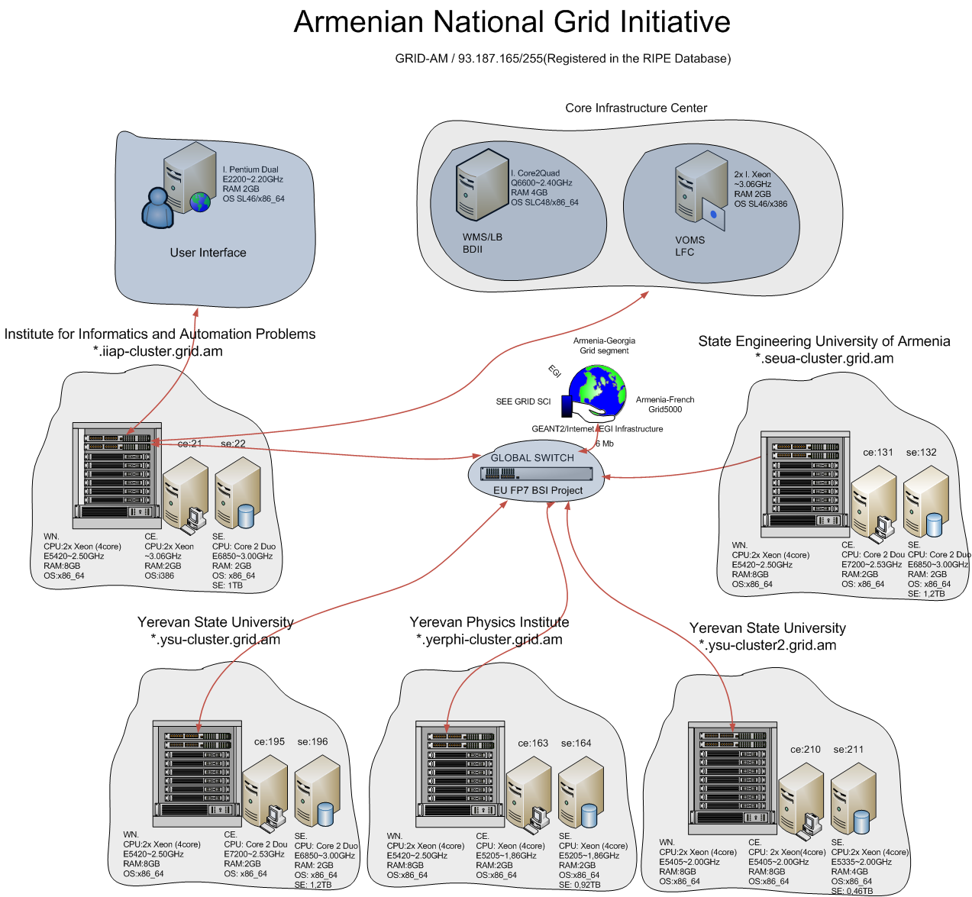
GRID - Armenia
Number of GRID sites: 6, total CPUs 496

Slide 13
GRID User Communities - Armenia
Meteorology: Implementation of the weather research and forecasting model (next-generation mesoscale numerical weather prediction and atmospheric simulation system) for operational usage by Armenian meteo office.
Astrophysics: Development of the Armenian Virtual Observatory and integration in the International Virtual Observatories Alliance.
Quantum Physics: Experimental investigations in areas of quantum information technologies and new nonlinear materials.
High Energy Physics: Collaboration with the CERN HEP experiments (ATLAS and ALICE VOs support by ArmGrid).
Mathematics & Informatics: Investigation of IT Infrastructure Library performance for computing GRIDs and development of the software prototype for effective adaptation of the library concepts to GRIDs; Systolic Algorithm Simulator; Development and realization of the decision-making parallel algorithms; Linear cryptanalysis.

Slide 14
GRID - Azerbaijan
2 new blade servers : 160 cores (Xeon 2.6 GHZ) and storage : 72 TB was received in 2011.
High Energy Physics: Collaboration with the CERN LHC ATLAS experiment.
Physics: extensive simulations in photoelectronics is planned.

Slide 15
GRID - Georgia
The GRID site GE-01-GRENA is located at GRENA and incorporated in the European GRID infrastructure. The average availability and reliability of the site is more than 99% .
Meteorology: Investigation of Advanced Research WRF (ARW) modeling system for weather research and forecasting.
Plasma Physics: Study of acceleration of charged particles in relativistic plasma heated by ultra-intense pulses of laser beam.
GRENA together with Tbilisi State University submitted project to the Shota Rustaveli National Science Foundation for the development of GRID infrastructure and services in Georgia.

Slide 16
Using HPC infrastructure in Europe
Armenia: Molecular Dynamics Study of Complex Systems
Parallel molecular dynamics simulation of Sodium dodecylsulfate (SDS) – polymer systems (inverse micellar and lamellar) depending on the temperature and the polymer concentration.
Blue Gene P Supercomputer, Sofia, Bulgaria
Georgia: Modeling of some biochemical processes with the purpose of realization of their thin and purposeful synthesis
Quantitative description and modeling of the biochemical processes (e.g. point mutation process in DNA).
NCIT-Cluster, Bucharest, Romania

Slide 17
Current European Commission FP7 Projects
European Grid Initiative: Integrated Sustainable Pan-European Infrastructure for Researchers in Europe (InSPIRE) - IIAP NAS RA, GRENA
High-Performance Computing Infrastructure for South East Europe’s Research Communities (HP-SEE) - IIAP NAS RA, AzRENA, GRENA
Central and Eastern European Networking Engine (CEENGINE) - IIAP NAS RA, AzRENA, GRENA
Policy Dialogue in ICT to an Upper Level for Reinforced EU-EECA Cooperation (PICTURE) - IIAP NAS RA, GRENA

Slide 18
Conclusions
During last few years important development of E-Infrastructure in South Caucasus countries has been made, however there is still significant gap between the developed European countries and region.
Fraction of scientific traffic is still low compare to commodity Internet, importance of GEANT network is not well recognized by the Governments.
More close cooperation is needed in the implementation of new services available at GEANT network.
Support from Governments and European Commission for the farther development of E-Infrastructure in South Caucasus countries is essential for the integration of scientific potential of the region in the European Research Area.

Slide 19
Thank you for attention!

